Slide 1

With great graphs comes great power
Baldur Magnusson
Early Development Biostatistics, Novartis Pharma AG
R/Pharma 2020

Slide 2
Acknowledgments
Alison Margolskee*
Marc Vandemeulebroecke*
Mark Baillie*
Andrew Wright
Julie Jones
Ivo Vranesic
Doug Robinson
Allison Florance
And many more…

Slide 3


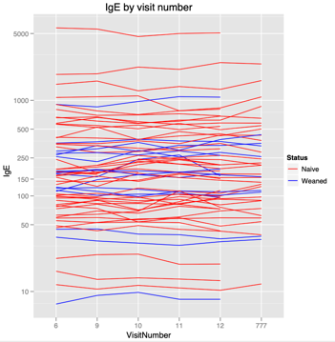
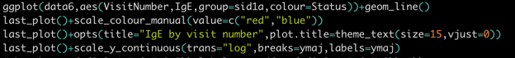
My start in data visualization
From a no-graph, data-free statistics PhD…
…into a highly exploratory environment
Google said: “try ggplot2!”

Slide 4

Plotting is fun, but…
A bad plot can be worse than no plot
Producing a lot of graphs $≠$ producing effective graphs

Slide 5
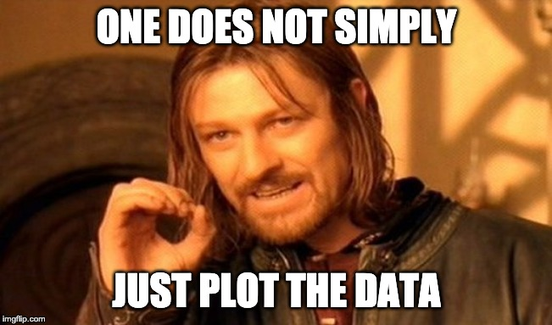
Great graphs are not trivial

Slide 6
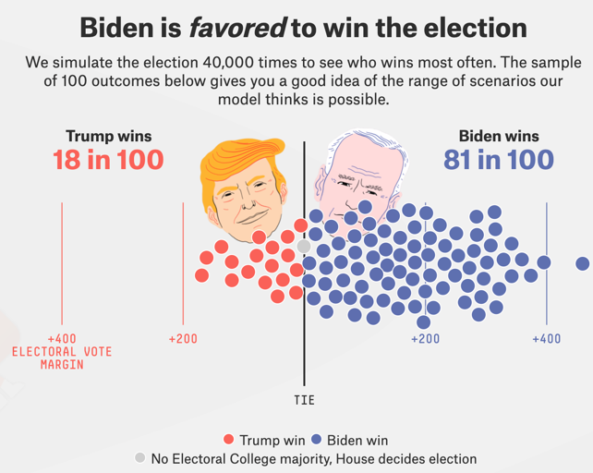
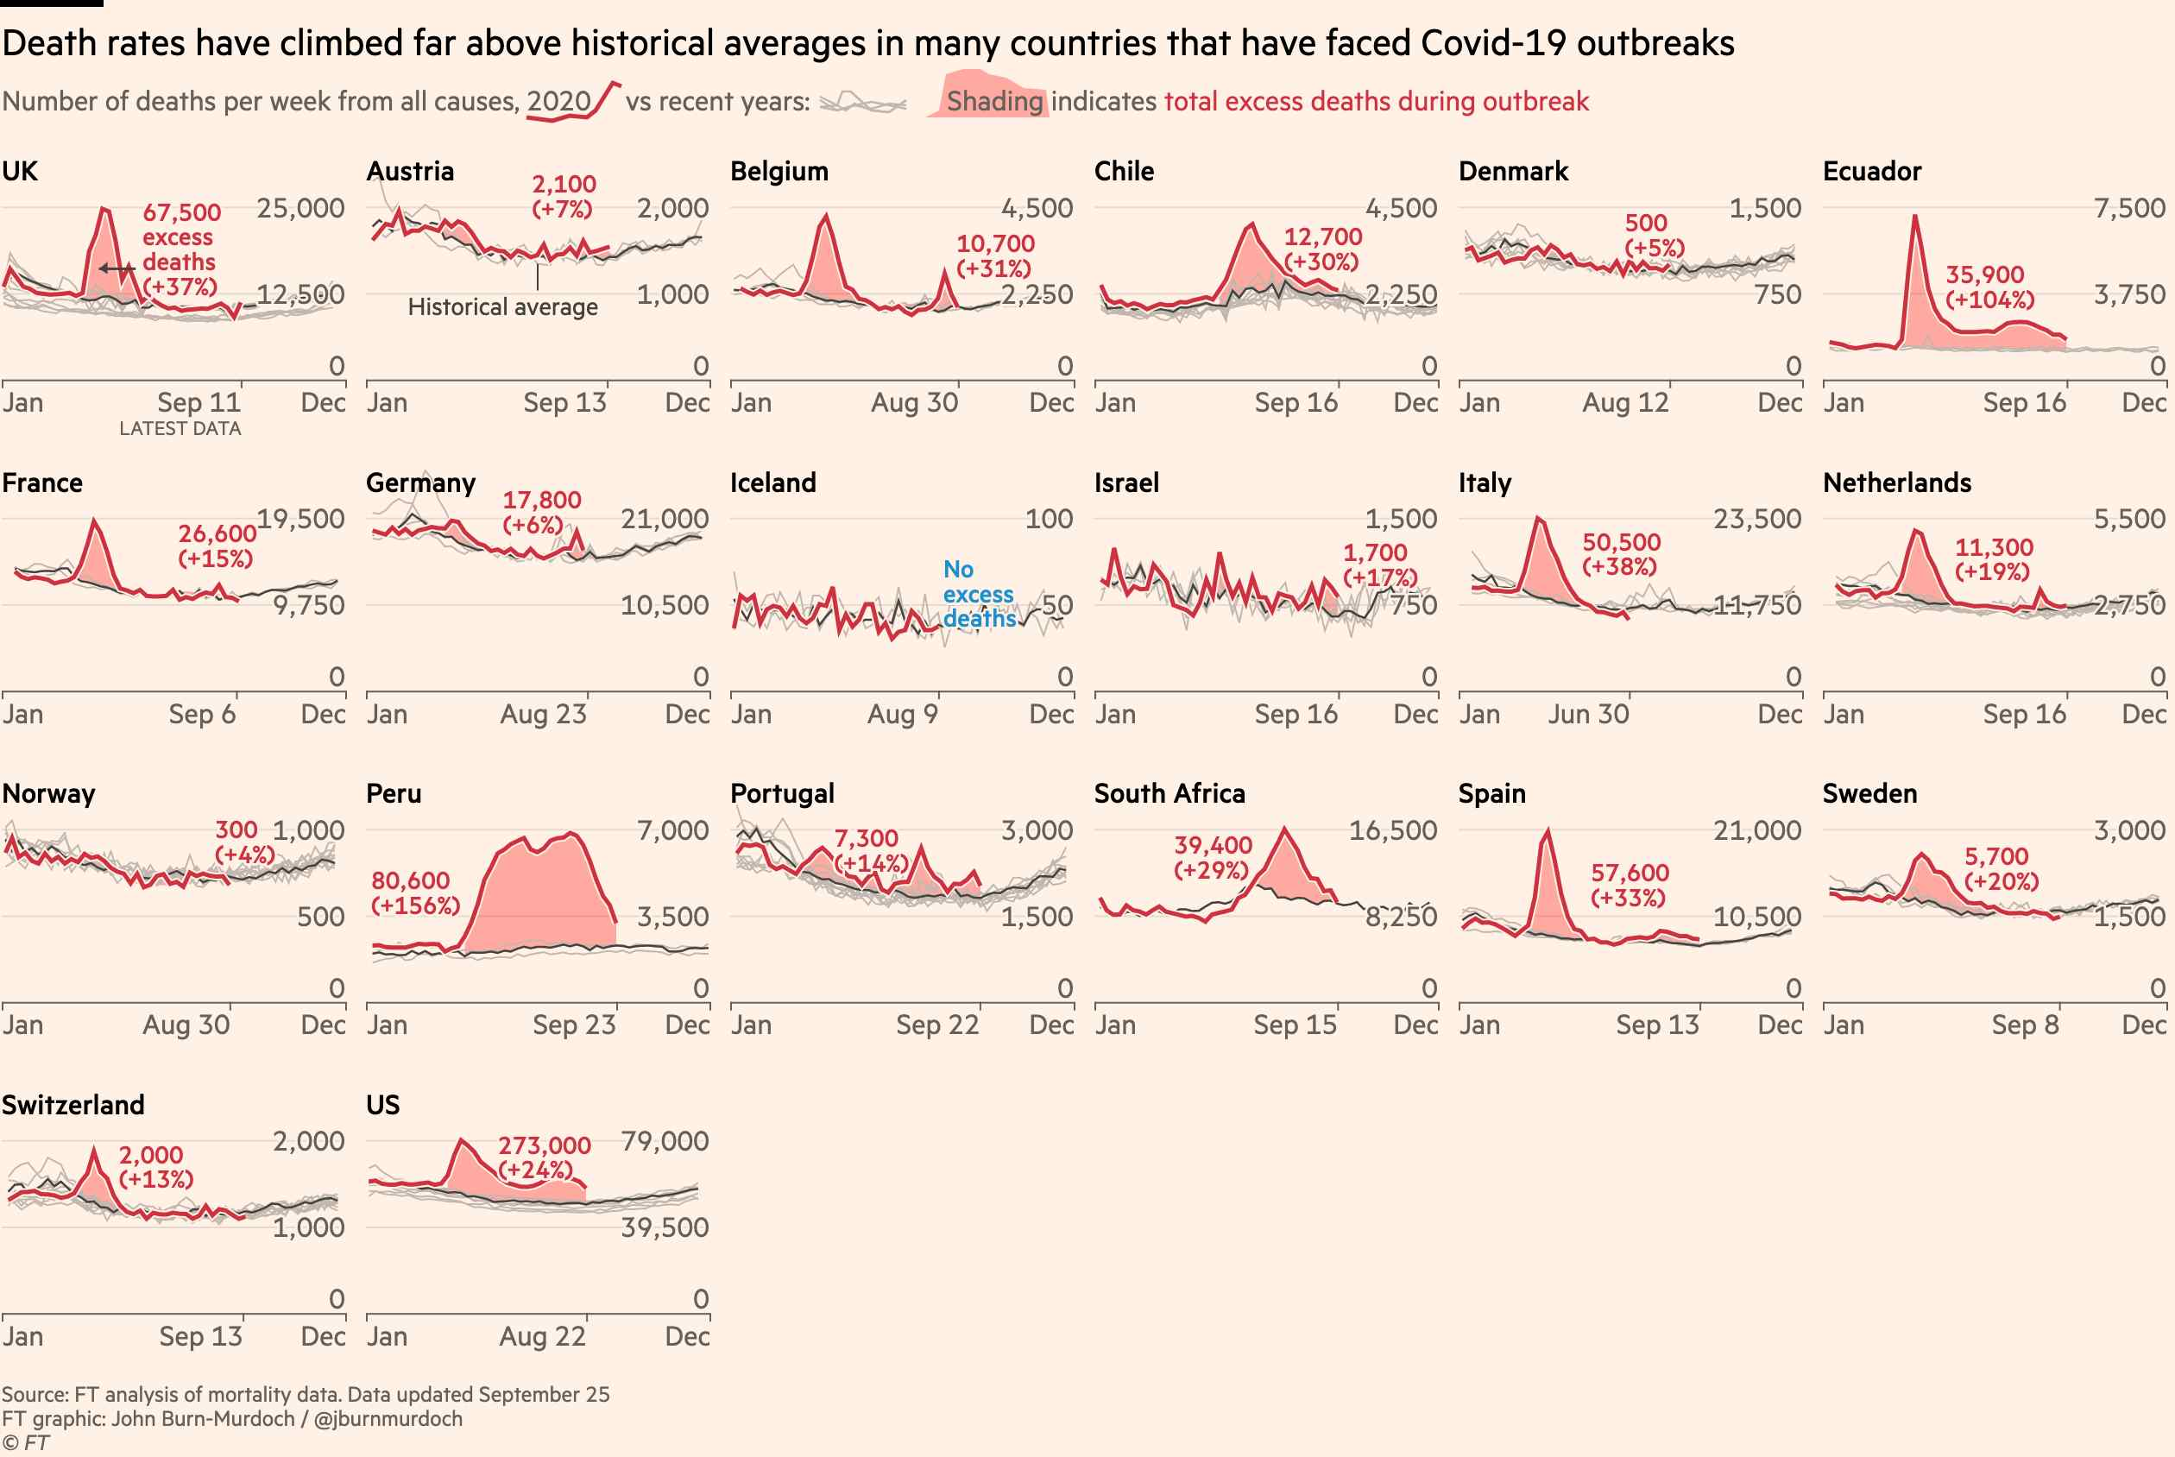
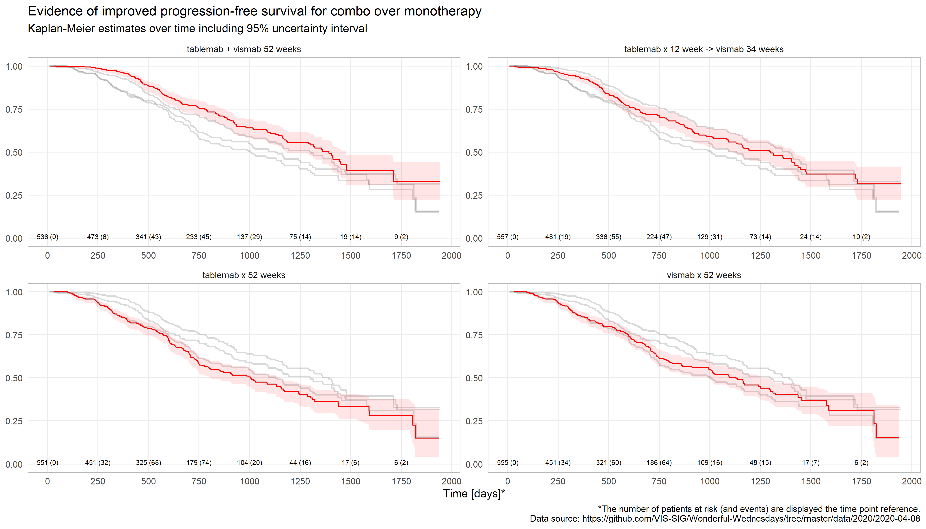
Effective visualizations are all around us
http://www.fivethirtyeight.com
http://www.ft.com/coronavirusfree
http://vis-sig.github.io/blog

Slide 7
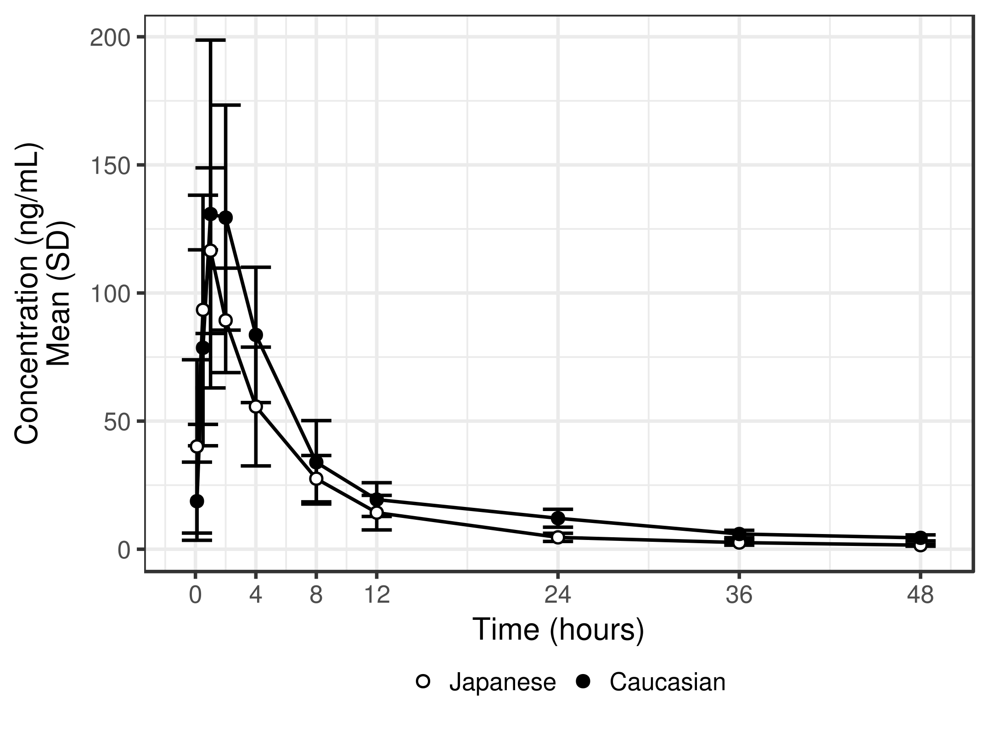
Is exposure different? How?
What are we supposed to conclude?

Slide 8
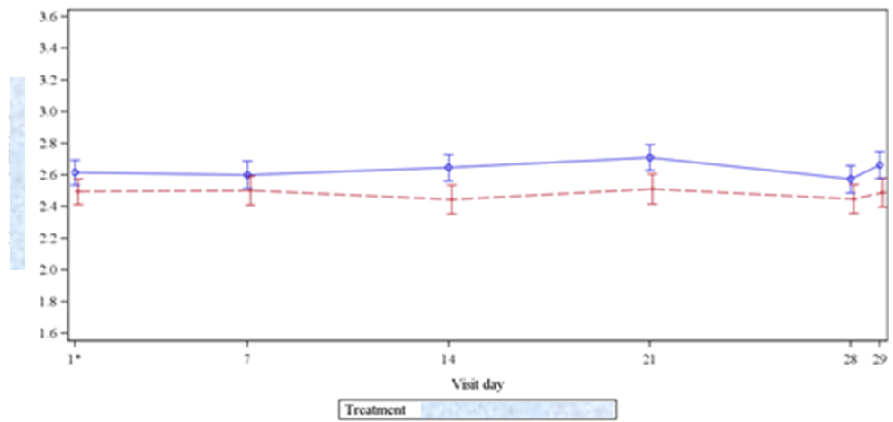
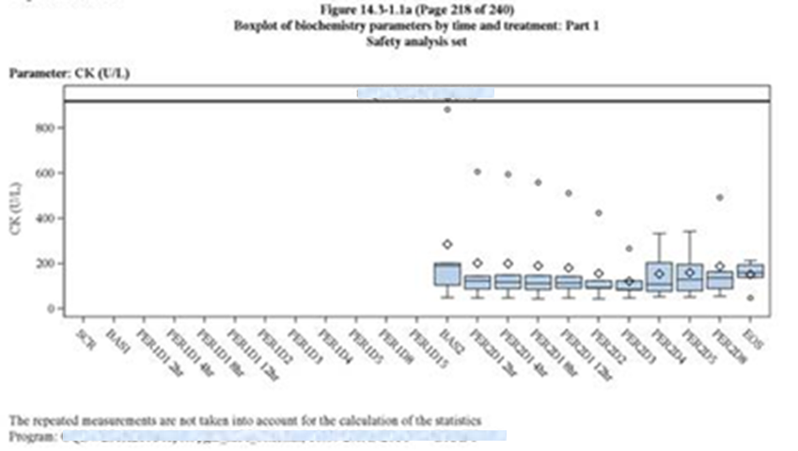
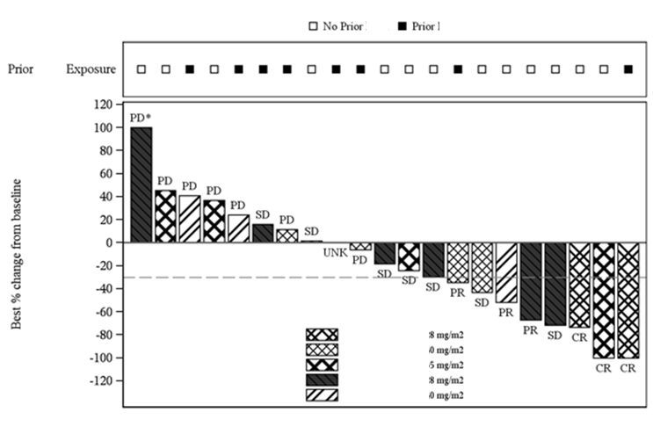
It is not hard to find more examples

Slide 9
What if we could do better?
We can…
What if we consistently did better?

Slide 10
How do we get there?
Know your purpose
Show the data clearly
Make the message obvious

Slide 11
Know your purpose
What is the question?
Who wants to know?
Why do they want to know?
What is the question?
Who wants to know?
Why do they want to know?

Slide 12
Show the data clearly
Simplify!
Maximize the signal over the noise
Show the relevant data directly

Slide 13
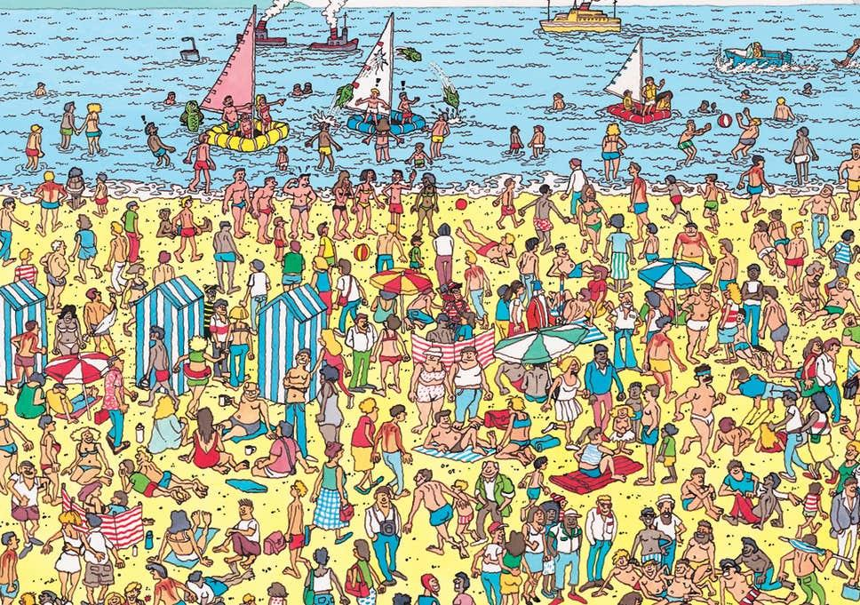
Tying it all together
Do you want your audience to play “Where’s Wally?”
Credit: Andrew Wright

Slide 14
Make the message obvious
Show the answer
Draw attention & do repeat yourself
Always add a title
Make the message impossible to miss

Slide 15
The elephant in the room…
No one-size-fits-all
Choose consciously for your situation
Make it a habit – test and repeat

Slide 16
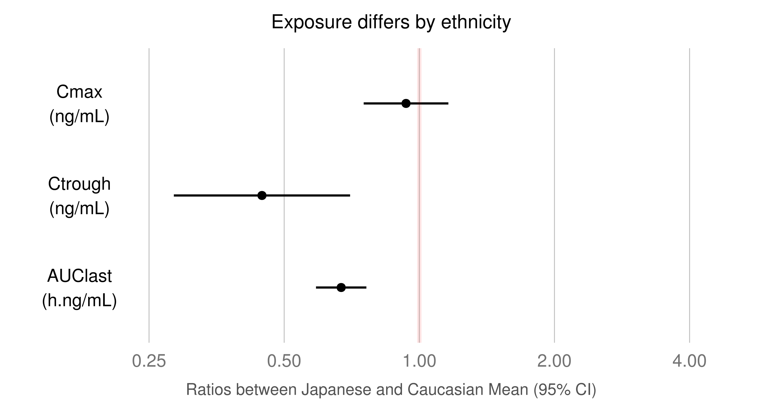
Is the exposure different? How?
f
0.93
Peak concentration is similar
0.45
Elimination is substantially faster in Japanese patients
0.67

Slide 17
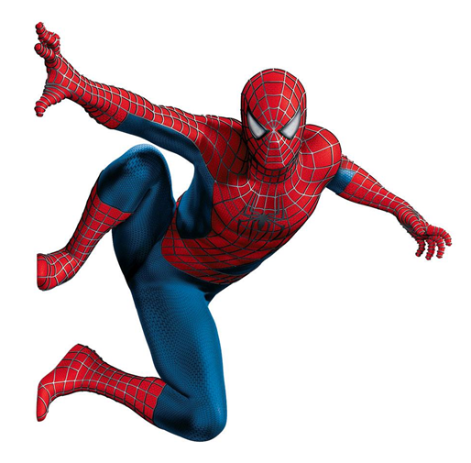
The goal of the quantitative scientist is to influence through data
With great graphs comes great power!
Influence → communication
Most effective medium: visual
Purpose – Clarity – Message

Slide 18
If you want to be more like Spiderman…
https://graphicsprinciples.github.io/
EVC video and tutorial
A graphics principles cheat sheet
xGx: https://opensource.nibr.com/xgx/
WW: https://github.com/VIS-SIG/Wonderful-Wednesdays
visR: https://openpharma.github.io/visR/

Slide 19
Thank you

